Slide 1

ITA0329 – MOBILE COMPUTING
Wireless Ad Hoc Network Visualizer & Emergency Messaging App
GUIDED BY
Dr.Saravanan.M.S
PRESENTED BY
Galla Sai Siddartha(192425093)
K.V.Charan Teja(192424167)

Slide 2


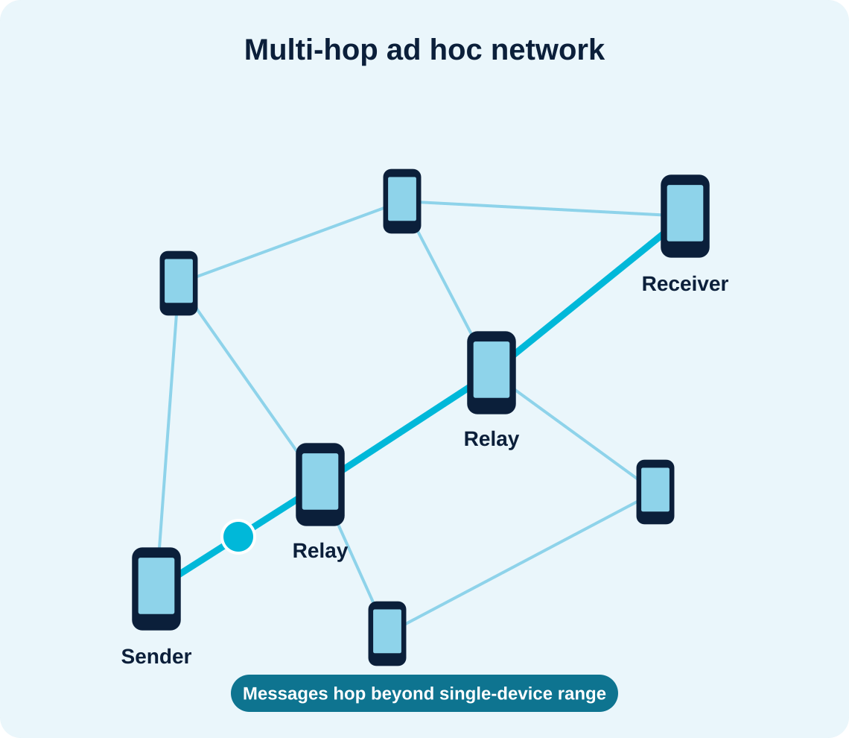
ABSTRACT
This project presents the Wireless Ad Hoc Network Visualizer & Emergency Messaging App, an Android-based system for multi-hop emergency communication.
It lets nearby Android devices discover each other, form an ad hoc network, and exchange emergency messages without a central access point or conventional infrastructure.
The proposed system has three modules: peer discovery and visualization, multi-hop emergency messaging with TTL, and store-and-forward delivery with performance analysis.
Unlike conventional messaging that depends on cellular or internet infrastructure, the proposed system works device-to-device, forwards messages through relays, and monitors the network.

Slide 3
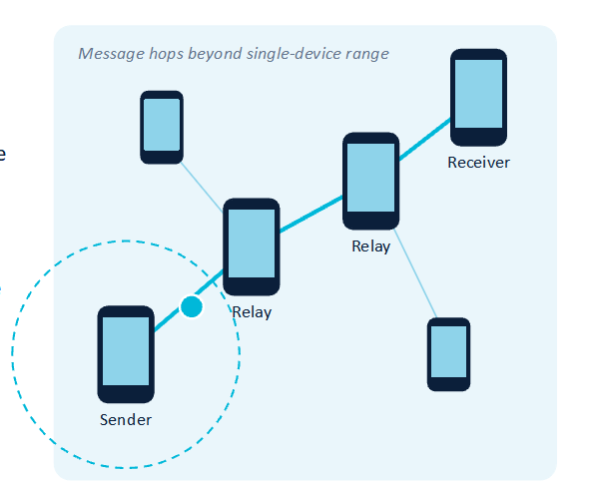
INTRODUCTION
A wireless ad hoc network connects devices directly, with no central access point.
This project is an Android app that discovers nearby devices and shows the network as nodes and links.
Emergency messages are forwarded through relay devices using multi-hop routing with a TTL limit.
Importance: communication can continue when cellular or internet infrastructure fails during outages and disasters.
Applications: disaster relief, search and rescue, remote areas, and crowded events with network outages.

Slide 4
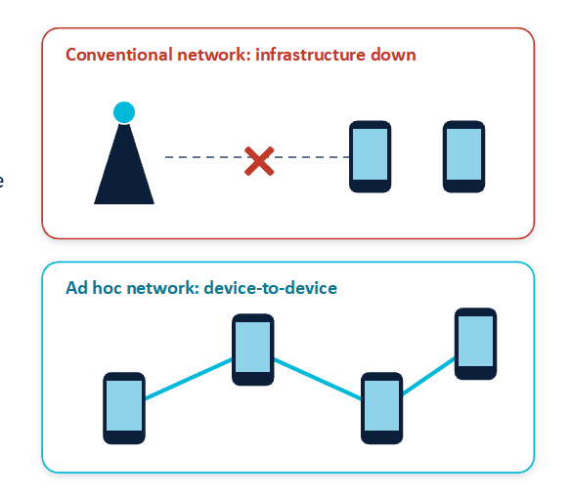
PROBLEM STATEMENT
Users cannot see which nearby devices are connected or how the topology changes when devices join or leave.Limited wireless range and device movement break direct paths, so emergency messages cannot reach distant receivers.

Slide 5
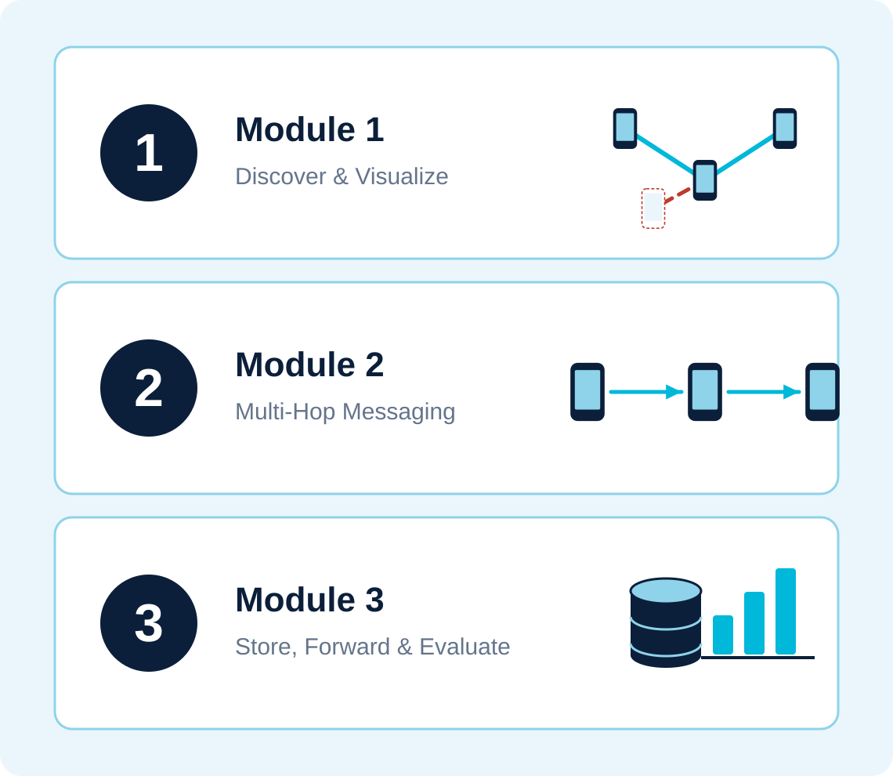
OBJECTIVES
Discover nearby devices, establish peer connections, and visualize them as a live network graph.
Implement multi-hop emergency message forwarding using TTL and duplicate detection.
Store undelivered messages locally for retry, and evaluate delivery rate, hop count, delay, network lifetime, and battery consumption.

Slide 6
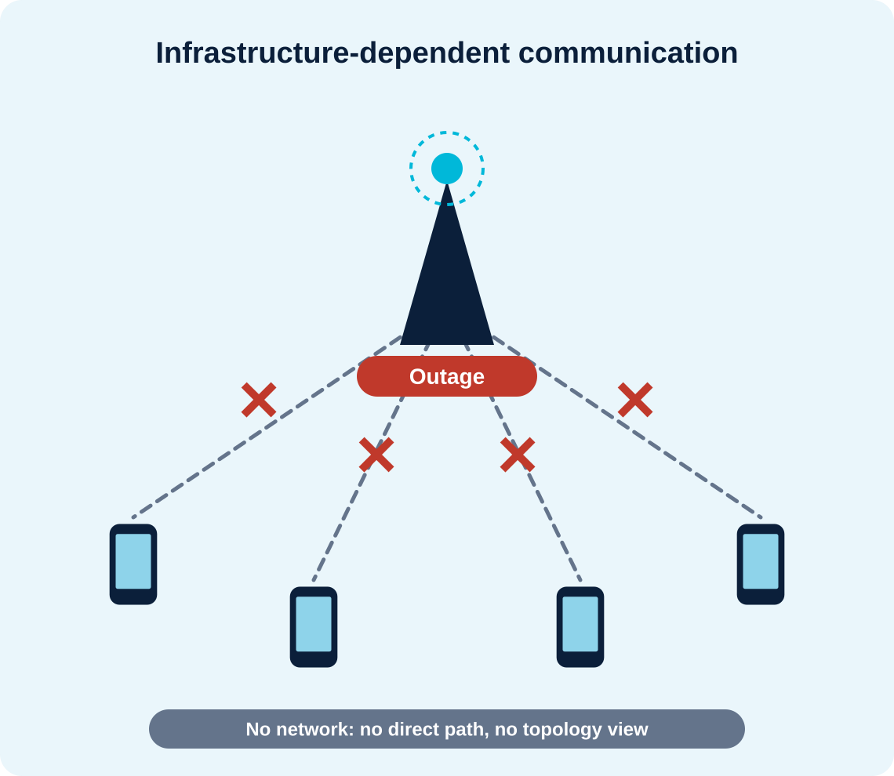
EXISTING SYSTEM
Conventional messaging depends on cellular or internet infrastructure.
Communication can fail during network outages and disasters.
Direct device-to-device communication has limited range.
Device movement can interrupt communication paths.
Limited visualization of network topology and message forwarding.

Slide 7
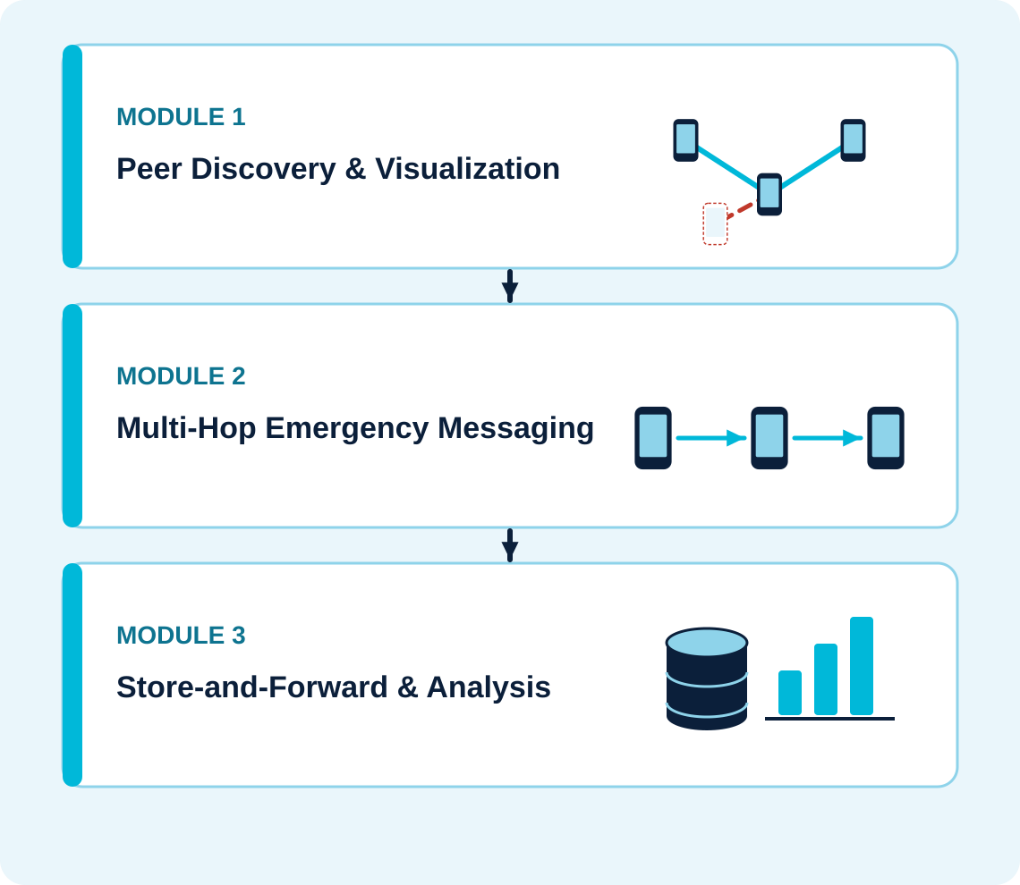
PROPOSED SOLUTION
Module 1 – Peer Discovery & Visualization: finds nearby devices with Wi-Fi P2P and Nearby Connections and draws devices as nodes and links as edges.
Module 2 – Multi-Hop Emergency Messaging: a custom application-layer router forwards messages through relays, using TTL and message IDs to limit propagation and duplicates.
Module 3 – Store-and-Forward & Analysis: a Room database keeps undelivered messages for retry, and a dashboard tracks delivery rate, hop count, delay, network lifetime, and battery use.

Slide 8
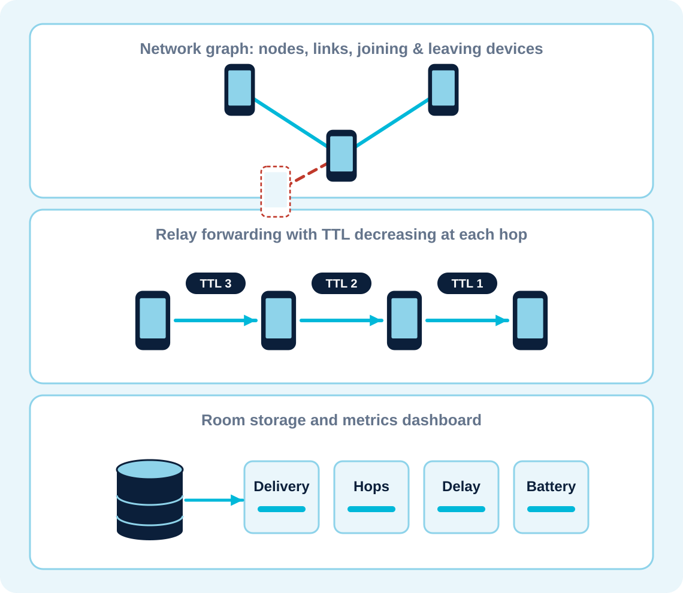
MODULES
Module 1 outcome: a live network graph showing connected devices, links, battery levels, and devices joining or leaving.
Module 2 outcome: emergency messages carried across multiple hops, with TTL-limited forwarding and duplicates not forwarded again.
Module 3 outcome: undelivered messages retried on reconnection, with delivery rate, hop count, delay, network lifetime, and battery use available for evaluation.

